Slide 1
DevSecOps: Secure Cloud Enclaves
Sprint 4: March 28 - April 11
Ethan McIlhenny, Avantika Dasgupta, Josh Manning, Dharmit Dalvi

Slide 2

Recap
Sprint 3:
Write Scripts to automate Object storage processes
Begin Logging
Configure Logging
OS Level Events
Services on the VM
Object Level Logging

Slide 3
Recap
Sprint 4 Goals:
Finish Logging
Script Logging Configuration and Deployment on a VM
Enable Log file validation
Accounts and Credentials
Implement system to rotate accounts and credentials from CONS3RT to OpenStack
Key Management and Encryption

Slide 4
CONS3RT - Motivation
CONS3RT is a cloud orchestration platform
Aims to manage cloud allocations and maintain high security standards
Typical User
Bring their own cloud purchased from a 3rd party
Purchase a cloud directly from CONS3RT

Slide 5
How does this motivate logging?
CONS3RT dashboard will do all of the provisioning in OpenStack
If the user does use OpenStack CLI, that emulates a hosted service on the VM
Logging on Individual VMs limited to
Hosted Services
System Logs (messages, secure)

Slide 6




Architecture
VM
Service
Secure Object Storage
/var/log
/test_log

Slide 7
Automation
Five Functions
Installing dependencies
Configure Filebeat
Configure Logstash
Launch Filebeat
Launch Logstash
Log_Setup.sh

Slide 8

DEMO

Slide 9
Other Services to Enhance Logs
This doesn’t cover it all, could be more secure
Fail2ban
TCPDump
Log File Validation

Slide 10

Fail2Ban
Intrusion detection/protection system (IDS/IPS).
Scans for brute force login attempts in real-time and bans the attackers with firewalld or iptables.
Blocks the IP addresses which show signs of brute force attacks or dictionary attacks.
This program works in the background and continuously scans the log files for unusual login patterns and security breach attempts
Notes:
(IDS) is a device or that monitors a n/w or systems for malicious activity or policy violations. Tracking Failed login entries, checking banned IPs, unbanning an IP address

Slide 11

TCPDump
Command line network sniffer
Used to collect network packets
Can be used to intercept traffic between multiple VMs within our cloudspace

Slide 12
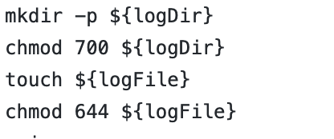
Log File Validation
To ensure that no one tampers with the logs to erase their activity.
Limiting write permissions to access the logs
Notes:
Chmod 644 - Read write permissions only for root users

Slide 13
Bucket Logging
Goal of sprint 3
Need to generate logs for all activities on buckets
Reads
Writes
Modifications
Deletions
Tried getting logs using the S3 API function
Tried sending logs to our S3 buckets through logstash
Did not succeed! :(
Notes:
Sending logs failed, no permission, it needs to be an actual S3 bucket. S3 API that interacts with CEPH doesn’t support bucket logging

Slide 14
Accounts & Credentials
Original goal of sprint 4
Enforce standards on passwords
Enforce changing of passwords every 60 days
This goal was removed from the agenda
We don’t have permission to change keystone credentials
MOC is moving away from giving out Keystone credentials
Institution SSO is being used
So, we moved on to Encryption instead
Notes:
Going away from giving everyone keystone creds
Using SSO instead
So it’s kind of taken care of

Slide 15

Motivation for Encryption
We want to have both at rest & in transit encryption
Compliance to government policies
The tenant could be at risk without it, as attackers could get access to user’s data

Slide 16

Barbican
Barbican is OpenStack’s Key Management System
It is compatible with Ceph S3 for server-side encryption of objects stored in buckets
Generates keys for encryption
Stores keys, passwords, certificates securely
But, does MOC support Barbican?

Slide 17
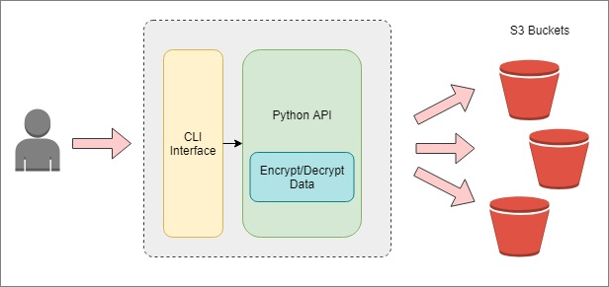
Proposed Workaround
Create an Object Storage API for users to interact with
Functions to create and delete buckets, upload, download, delete objects from buckets
Data will be locally encrypted/decrypted when taking in/out of buckets
Logs will be generated for each event on a bucket (reads, writes, modifications, deletions, creations) and stored in S3 buckets
Python API will be wrapped in a Shell script
Client will only need to use a CLI interface to interact with the API

Slide 18
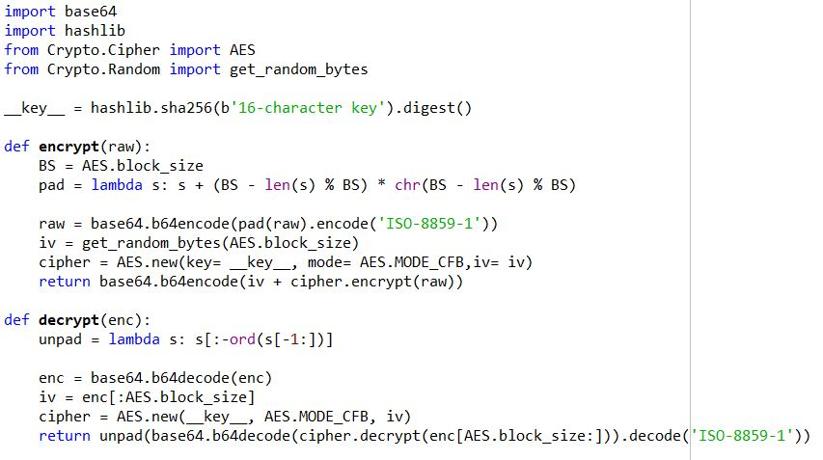

Slide 19
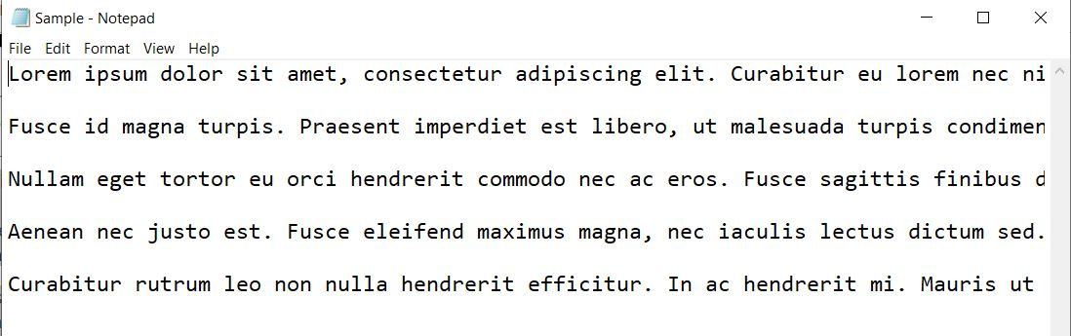
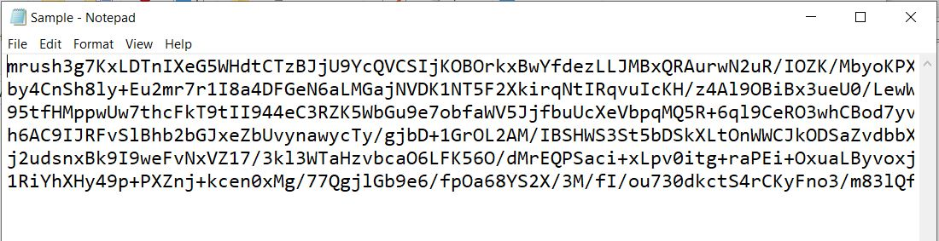
Encryption S
Notes:
What we have already is a Python script that takes a 16-character key and encrypts text files

Slide 20
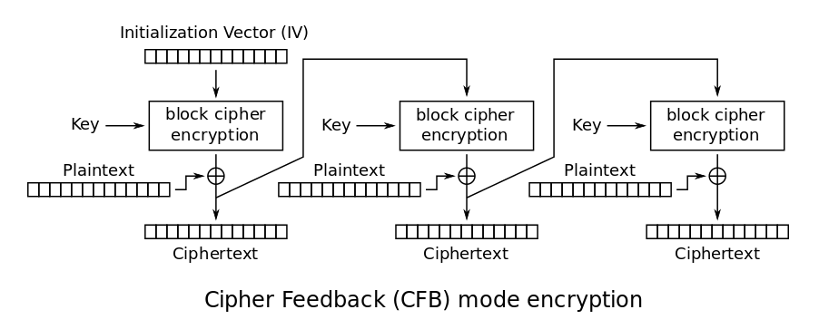
CFB
Encrypted with Cipher Feedback
Close relative to CBC
Their decryption schemes are in fact identical
Used as a stream cipher

Slide 21
Challenges with Workaround
Storing keys locally is a bad practice
Rotation of keys
Generating keys
Encrypting media files
Script reads a file line by line and encrypts each line
Same with decryption
More than 1 sprint of effort

Slide 22
Transit Encryption
Have to enable TLS
Allows for CIA and more!
Confidentiality, integrity, authentication
PKI is the framework for this
Requires certificates, keys both private and public
Certificates: Contain verifiable
Issued with a centralized, trusted CA
X.509 is the standard

Slide 23
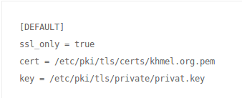
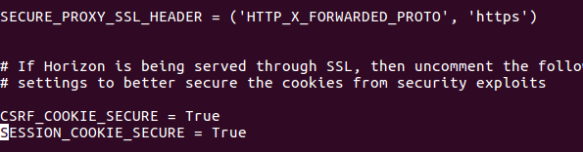
Enable TLS encryption: more config files to play with

Slide 24

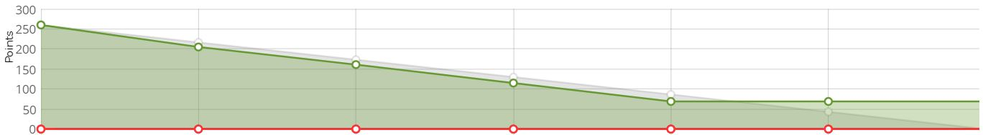
Burndown

Slide 25
Future Work
Create API Framework for Bucket Writing and Reading
Key Management and Encryption
Combine Scripts and Assetize within CONS3RT
Test our Framework
Need to make sure it is actually secure
Notes:
MVP is done-ish
Logging is mostly done
Bucket read/write hasn’t been done yet

Slide 26
Questions?

